Slide 1
Capital Asset Management

Slide 2
Condition of our assets has a significant impact on the lives of citizens

Slide 5
How do we make the most of limited resources to maintain our assets?

Slide 6
Assess the condition of our assets Prioritize the highest needs Maintain our assets effectively Replace assets past their useful life Dispose of liabilities or surplus assets

Slide 7
We have completed condition assessments on all our major buildings

Slide 8
We are doing long-term planning for maintenance and replacement

Slide 9
We have developed building design standards and requirements

Slide 10
We are reducing energy costs and GHGs

Slide 11
Working on a preventative maintenance program and portfolio management strategy

Slide 12
Challenges

Slide 13
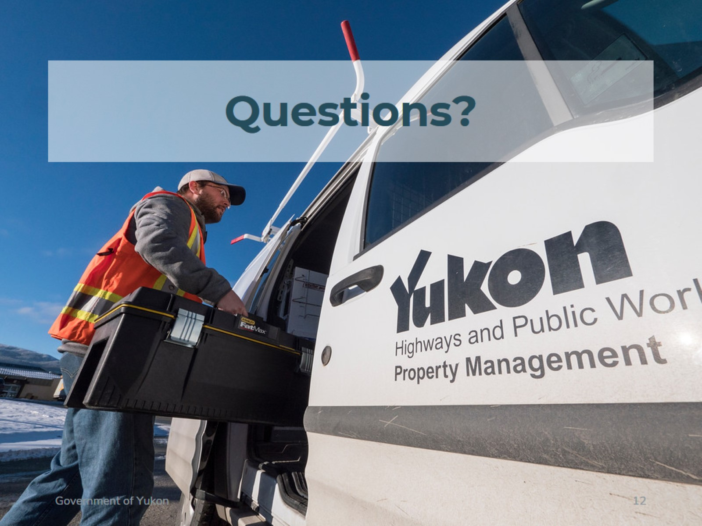
Questions?

